Slide 1
Database Structure
Topic : Billing Software
Members :
Ali Shazin
Hana Shihab
Sreedevi

Slide 2
TABLES USED
productdetails
pricetracker
bill
billdatetracker
backupproducrdetails

Slide 3
FILES USED
bill_count.bin
product_count.bin

Slide 4
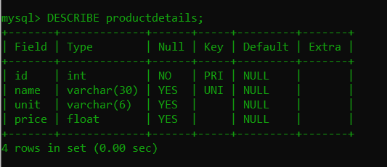
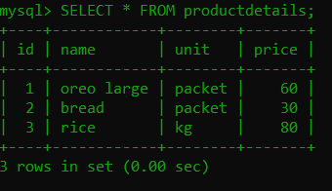
productdetails -> table

Slide 5
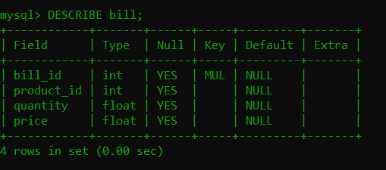
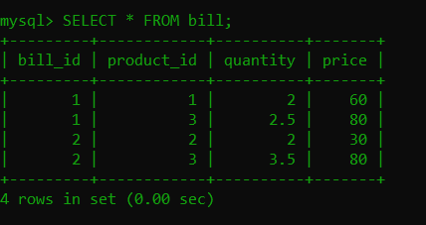
bill -> table

Slide 6
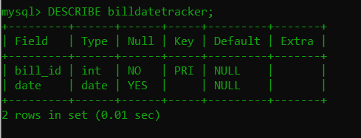
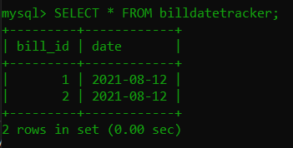
billdatetracker -> table

Slide 7
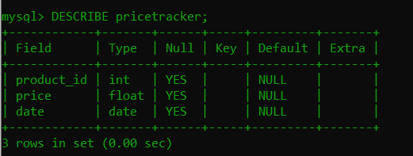
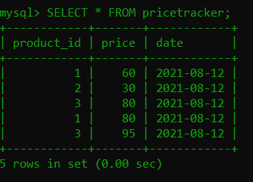
pricetracker -> table

Slide 8
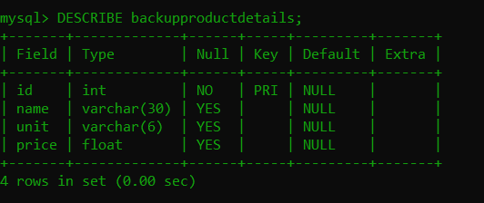
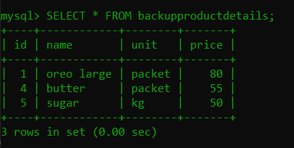
backupproductdetails -> table

Slide 9
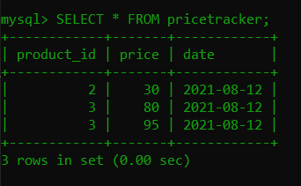
pricetracker (After)

Slide 10
bill_count.bin -> file
This binary file is used as a replacement for AUTO_INCREMENT in MySQL.
It helps us to provide a bill with a continuing and non-repeating bill ID.

Slide 11
product_count.bin -> file
This binary file is used as a replacement for AUTO_INCREMENT in MySQL.
It helps us to provide a product with a continuing and non-repeating product ID.

